Slide 1
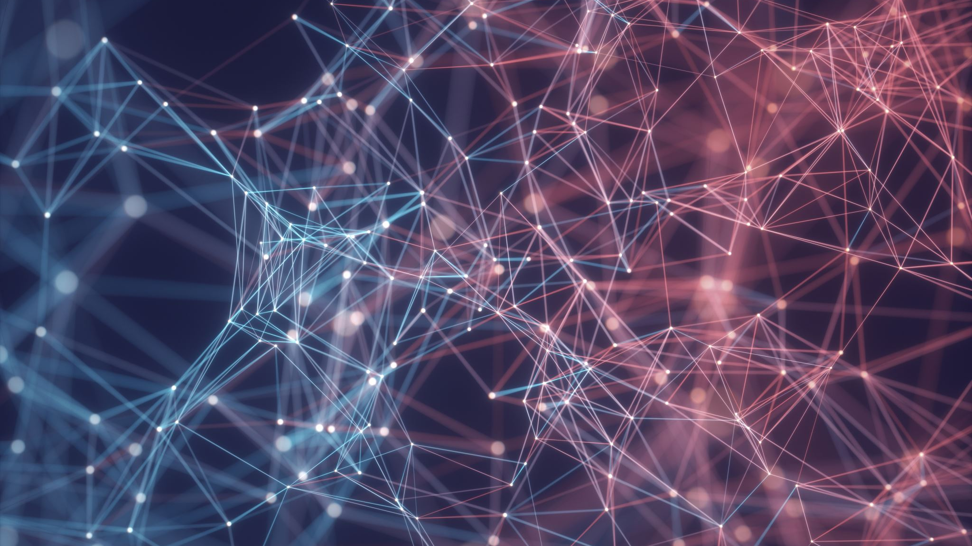
Smart Systems Convolutional Neural Networks
Presentation by Marius Landmann and Anna Dodik
9th of July 2020

Slide 2








Content
CNN Fundamentals
Training material
State of the art
GitHub
[1]
Google Collaboratory
Implementation of a CNN
Our project plan
Our achieved goals and experience

Slide 3
Content
CNN Fundamentals
Training material
State of the art
GitHub
[1]
Google Collaboratory
Implementation of a CNN
Our project plan
Our achieved goals and experience

Slide 4
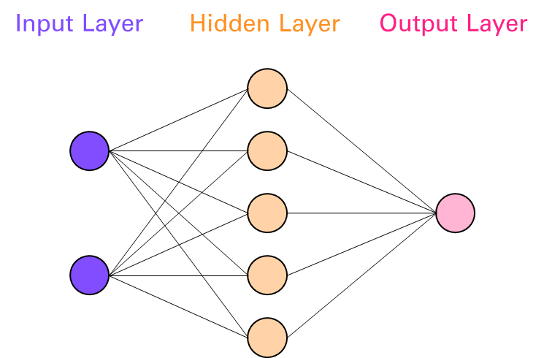
CNN Fundamentals
What is a CNN?
Learning phase
CNN basic structure
CNN = Convolutional Neural Network
Models characteristics of the human brain
Artificial intelligence
Phase 1:
Training
Phase 2:
Validation

Slide 5
CNN Fundamentals - Layers
Input Layer
Convolutional Layer
Max Pooling Layer
Flatten Layer
Dense Layer (output)
Image
Other types of data
Detect patterns
Reduction of dimensions
Transforms a matrix into a vector
Connects each input with each output

Slide 6
CNN Fundamentals - Hyperparameter
Variable parameters that influence net optimization
Optimization: Minimization of the error function
Are set before the training starts
Network structure variables:
Number of hidden layers
Network training variables:
Number of epochs
Learning rate

Slide 7
Content
CNN Fundamentals
Training material
State of the art
GitHub
[1]
Google Collaboratory
Implementation of a CNN
Our project plan
Our achieved goals and experience

Slide 8
Training material
Training material
Theory
Practice
Script
Presentation
Script
Presentation
Basic knowledge
Advanced knowledge

Slide 9
Training material
Theory
Learning objective
Task
New content
Introduction
Soft- & Hardware
CNN optimization approaches
Data set
CNN workflow

Slide 10
Training material
Practice
Learning objective
Task with explanation
Introduction
CNN creation
CNN for traffic light detection
Software set up
Truck project
Neural network creation
Data set creation

Slide 11
Content
CNN Fundamentals
Training material
State of the art
GitHub
[1]
Google Collaboratory
Implementation of a CNN
Our project plan
Our achieved goals and experience

Slide 12
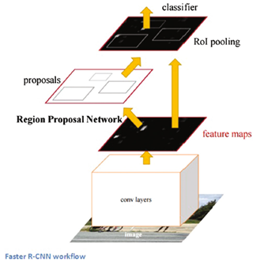
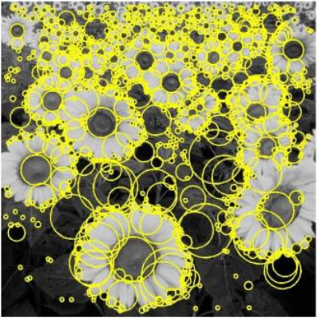
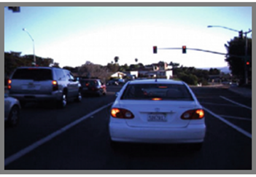
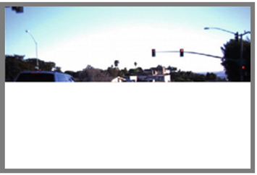
State of the art – Literature research
Faster R-CNN
BLOB detection
Image cropping
[3]
[2]
[4]

Slide 13
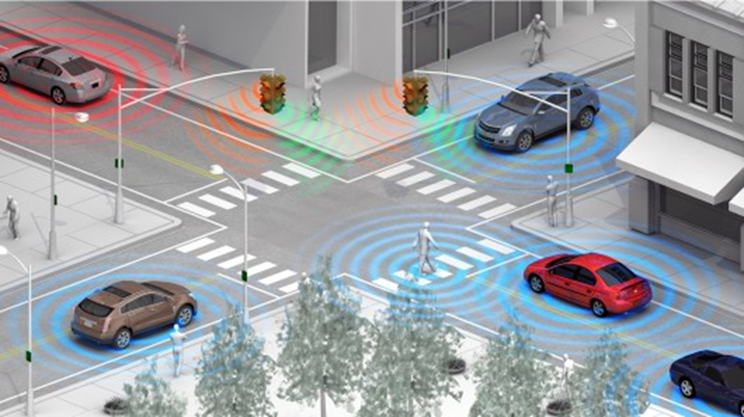
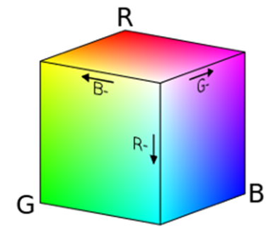
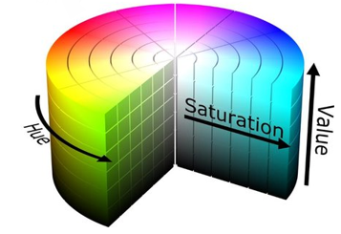
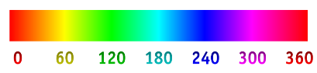
State of the art – Literature research
Vehicle to infrastructure
RGB colour space
HSV colour space
[5]
[5]
[7]
[8]

Slide 14
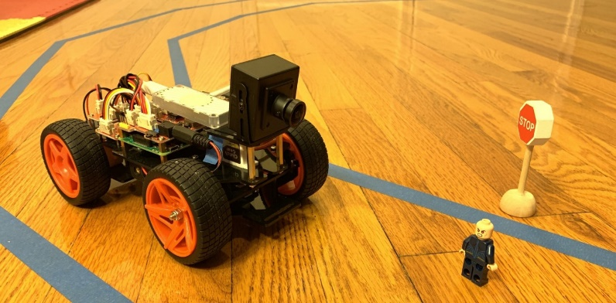
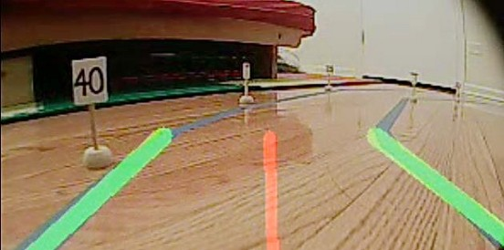
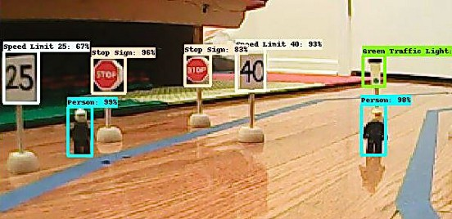
State of the art – DeepPiCar
[9]
[9]
[9]

Slide 15
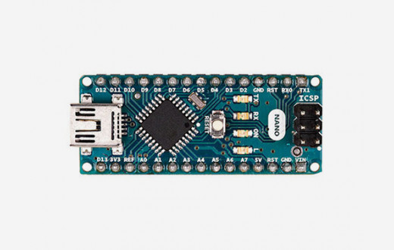
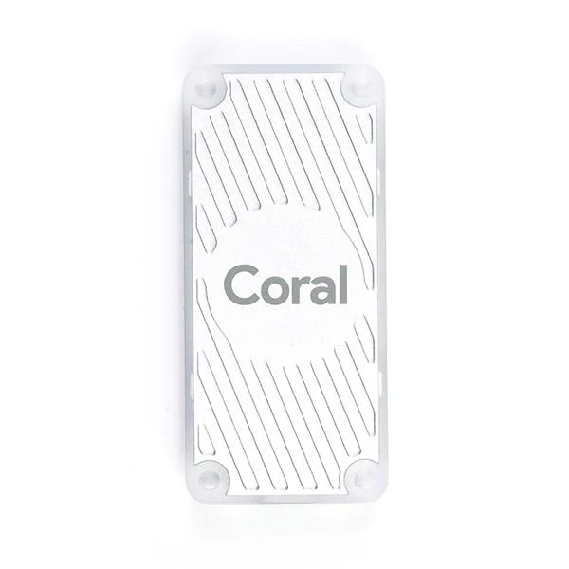
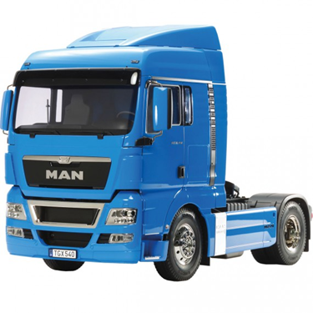
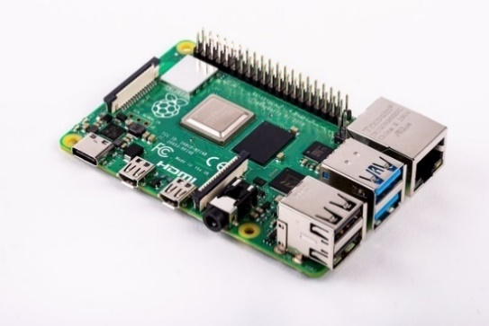
State of the art – Project Hardware
Arduino Nano
TPU
Smart Truck
[10]
Raspberry Pi
[12]
[13]
[11]

Slide 16
State of the art – CNN applications
TELSA Autonomous Car
Police Robot
Face Recognition
[15]
[14]
Personalized Marketing
[16]
[17]

Slide 17




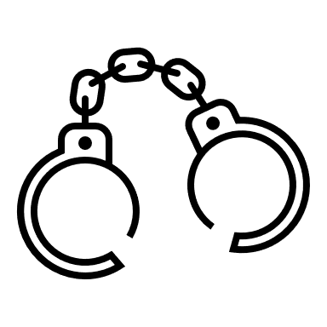
State of the art – Ethical problems
?

Slide 18
Content
CNN Fundamentals
Training material
State of the art
GitHub
[1]
Google Collaboratory
Implementation of a CNN
Our project plan
Our achieved goals and experience

Slide 19
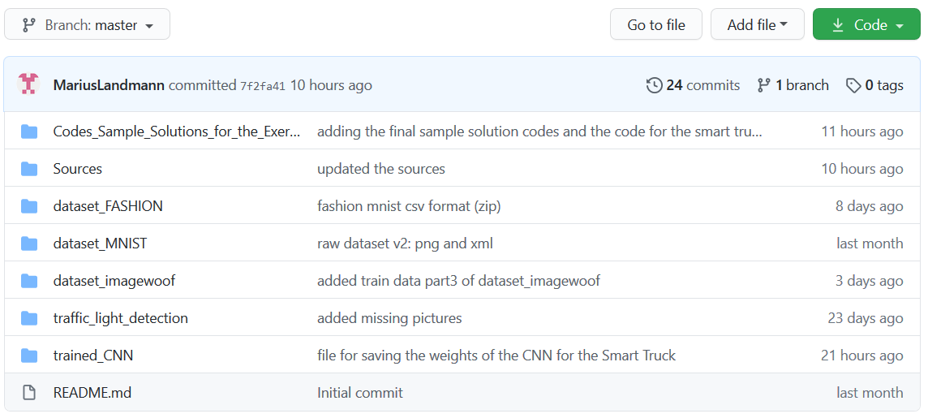
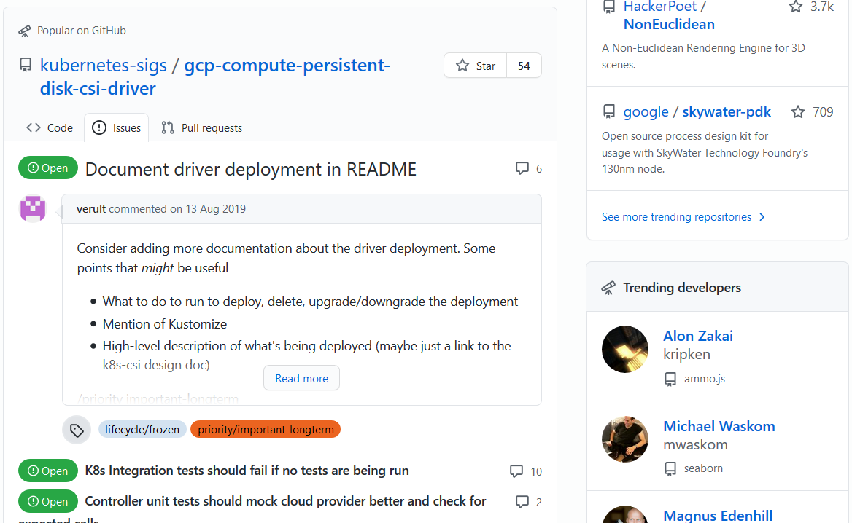
GitHub
Platform where people can work together
Shared knowledge
Access to several project documentations including their codes

Slide 20
Content
CNN Fundamentals
Training material
State of the art
GitHub
[1]
Google Collaboratory
Implementation of a CNN
Our project plan
Our achieved goals and experience

Slide 21
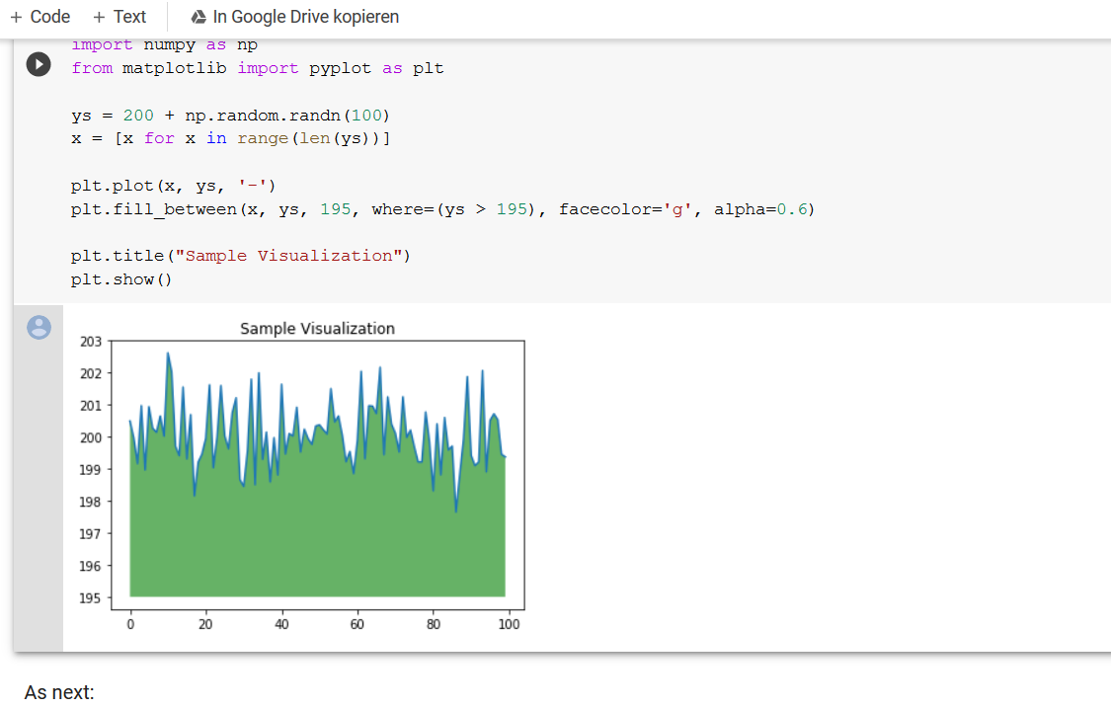
Google Collaboratory
Cloud-based platform
Machine learning (with tensor flow)
GPU and TPU can be used for free
It is possible to:
Write, run, and share code
Visualize data
Comment

Slide 22
CNN Fundamentals
State of the art
GitHub
Google Collaboratory
Implementation of a CNN
Training material
Our project plan
Our achieved goals and experience

Slide 23
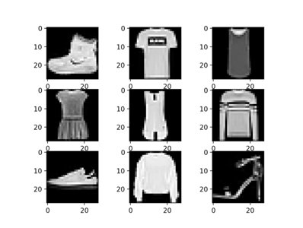
Implementation of a CNN - Lab: Fashion MNIST
70.000 pictures of clothes
10 classes
28x28 pixel
simple neuronal network
Focus on the environment of the neuronal network
[18]

Slide 24
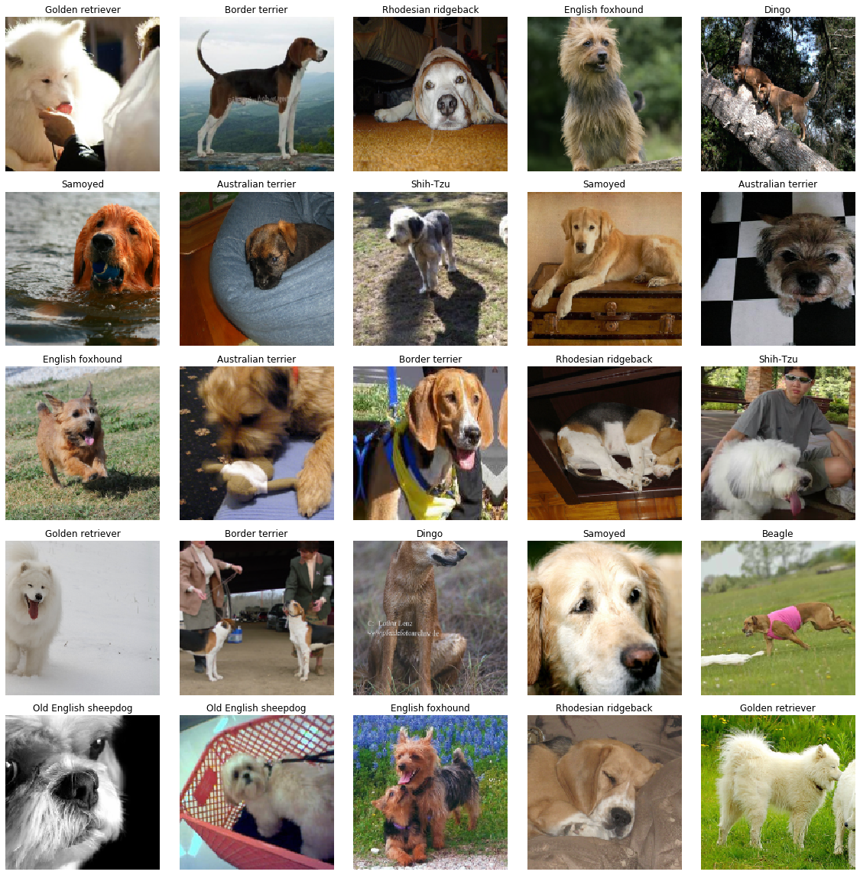
Implementation of a CNN - Lab: ImageWoof
13.000 different pictures of dogs
10 classes (dog breed)
Minimum size: 320x320 pixel
more complex CNN
Focus on the CNN layer structure
[19]

Slide 25
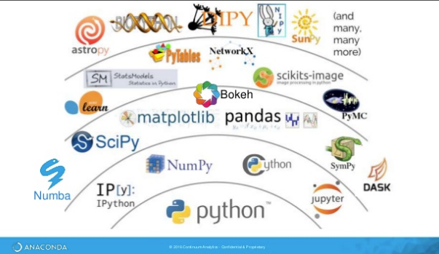
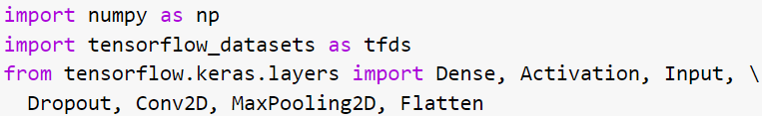
Implementation of a CNN - Libraries and Tools
Installing and importing the
needed libraries and tools
[20]

Slide 26

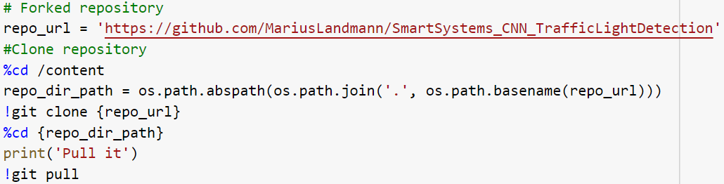
Implementation of a CNN - Repository
Forking and cloning
of your repository
[21]

Slide 27
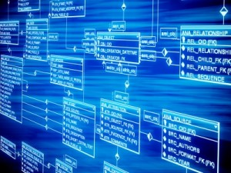
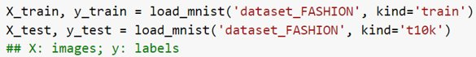
Implementation of a CNN - Load the dataset
Cloned repository (data path)
OR
Start the download in the python code (import)
[22]

Slide 28
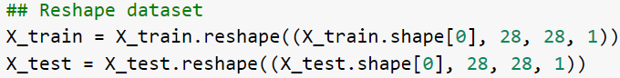
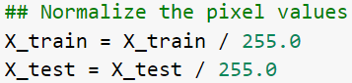
Implementation of a CNN - Preprocess the data
Reshape
Shuffle
Normalizing the pixel value
Convert labels to vectors

Slide 29
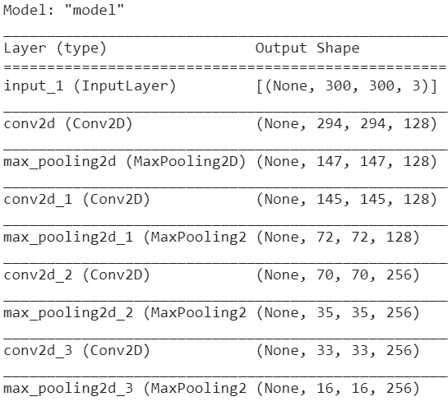
Implementation of a CNN - Layer structure
Basic layer structure for the fashion MNIST neural network
More complex layer structure for the ImageWoof CNN

Slide 30
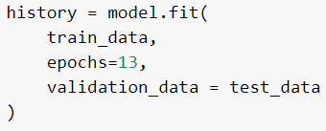
Implementation of a CNN - Training and Evaluation
Train the CNN by feeding the train dataset to the created model for several epochs
Evaluate the model by testing the model with the test dataset

Slide 31
Implementation of a CNN - Saving the Model
Saving the trained model in the forked repository
Able to recreate the model easily
Able to download the trained model

Slide 32
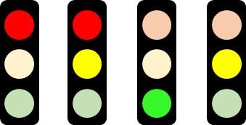
Implementation of a CNN - Smart Truck
Goal: Create a CNN for traffic light detection and implement it in the Smart Truck
The project is not finished yet
The student's knowledge and understanding is now at a level which enables them to work further on the CNN for the Smart Truck

Slide 33
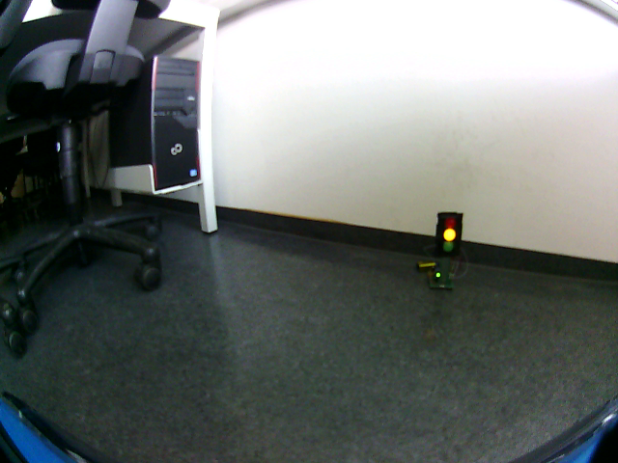
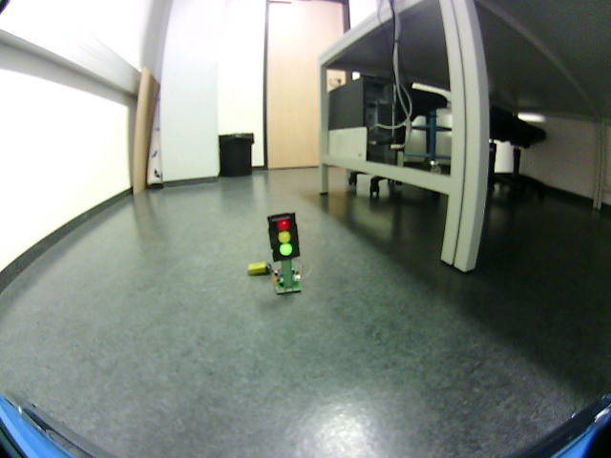
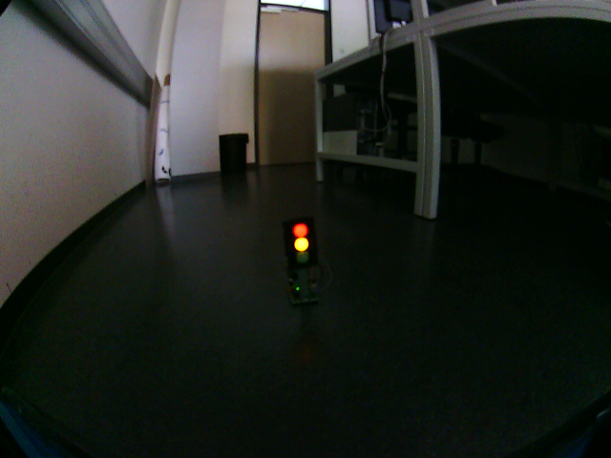
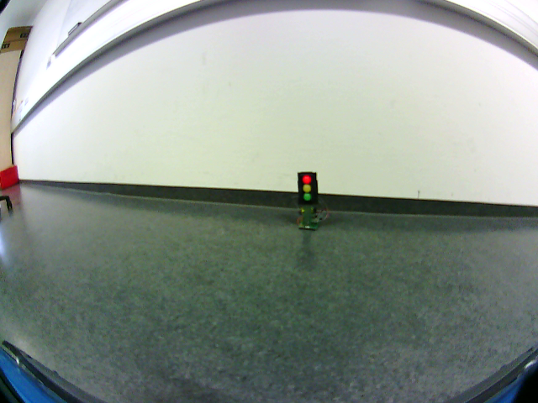
Implementation of a CNN - Dataset creation
Image creation
Image labelling
Data augmentation
Different data sets
Integration to repository

Slide 34
Implementation of a CNN - TFRecord
Is a record oriented binary format
By using binary code, the system processes the input data faster than before
Important:
Use the two codes in the repository (xml_to_csv.py, generate_tfrecord.py)
Convert the xml files to a single csv file
Generate the TFRecord files

Slide 35
Implementation of a CNN - State of the CNN
Actual state
Future Workload
Forked repository with the created dataset
Able to load the dataset
Able to generate the TFRecord file
Tested and documented the best approaches with different models
Able to save the future model
Feeding the TFRecord files into the CNN
Adapt the CNN to the TPU requirements
Run it on the Smart Truck
Optimization

Slide 36
Content
CNN Fundamentals
Training material
State of the art
GitHub
[1]
Google Collaboratory
Implementation of a CNN
Our project plan
Our achieved goals and experience

Slide 37
Our project plan
Participation at the Open HPI course
Introduction to the Smart Systems course
Literature review
Program the CNN environment
Data set creation
Working with GitHub and Google Colab to create a CNN
Creation of lab and lecture teaching material
M1
M2
M3
20.03.2020
24.04.2020
28.05.2020
09.07.2020
Milestones:
M1 Open HPI course is finished.
M2 Literature review is finished and the first steps in the truck project were made.
M3 Lab and lecture teaching material is created. A functional CNN is implemented into the truck.

Slide 38
Our project plan
Nr. | Tasks that are in general necessary to reach the "final goal" ("final goal" = autonomous driving truck that reacts according to the traffic light) | Goal description | Planned time units | Used time units | Done?
 |  |  |  |  | [Yes] / [No]
1 | decide about "final traffic light model" (build/bought) | Decision which type of traffic light should be used in condition to be able to create the data set. | 1 | 1 | Yes
2 | find and implement a labelling software for data set | Information about labelling software collected. Based on the information was a labelling software for the dataset chosen and installed. | 4 | 12 | Yes
3 | take pictures for first data set | Pictures of the chosen traffic light with the truck webcam were taken and stored. | 6 | 5 | Yes
4 | research and create a repository (database) with GitHub. The database is needed for the dataset which will get used. | Information about GitHub as a repository (database) is collected. The repository is created accordingly. | 5 | 7 | Yes
5 | data augmentation | More pictures were taken for the data set and augmented. | 3
6 | Label the pictures for the dataset | Label the pictures for the dataset. | 4 | 7 | Yes
7 | create a first small data set | Information about the data set creation were selected. The dataset was created with the first pictures we took. | 3 | 7 | Yes
8 | create the training data set | Training data set was created. | 1 | 0,1 | Yes
9 | create validation data set | Validation data set was created. | 1 | 0,1 | Yes

Slide 39
Content
CNN Fundamentals
Training material
State of the art
GitHub
[1]
Google Collaboratory
Implementation of a CNN
Our project plan
Our achieved goals and experience

Slide 40


Our achieved goals and experience
Achieved goals
Non-achieved goals and future challenges
Data set created
Teaching material prepared
Neural network coded
CNN coded
Set up of the CNN for traffic light detection (partly)
Unable to process TFRecord files
CNN not adjusted for the TPU
CNN not implemented to the truck

Slide 41


Our achieved goals and experience
Negative things /
difficulties
Positive things
Even small steps required significant time investment
Specific problems required individual solutions
Debugging was quite challenging and time consuming
Gained a lot of experience
Independent working
Applied project management knowledge
Preparation for further research activities
Interesting and future-oriented topic
Acquired a lot of knowledge and new skills

Slide 42
References
[1] GitHub, GitHub (logo). [Online]. Available: https://​github.com​/
[2] S. Ren, K. He, R. Girshick, and J. Sun, “Faster R-CNN: Towards Real-Time Object Detection with Region Proposal Networks,” Jun. 2015. [Online]. Available:http://​arxiv.org​/​pdf/​1506.01497v3​
[3] M. Kekoa, Blob Detection. [Online]. Available: https://​www.slideserve.com​/​maik/​blob-​detection-​powerpoint-​ppt-​presentation
[4] G. Symeonidis, P. P. Groumpos, and E. Dermatas, “Traffic Light Detection and Recognition Using Image Processing and Convolution Neural Networks,” in vol. 1084, Creativity in Intelligent Technologies and Data Science, A. G. Kravets, P. P. Groumpos, M. Shcherbakov, and M. Kultsova, Eds., Cham: Springer International Publishing, 2019, pp. 181–190.
[5] Transportationops, Vehicle to infrastructure. [Online]. Available: https://​www.transportationops.org​/​V2I/​V2I-​overview
[6] Wikipedia, RGB colour cube. [Online]. Available: https://​de.m.wikipedia.org​/​wiki/​Datei:​RGB_​color_​cube.svg
[7] V. Popov, M. Ostarek, and C. Tenison, “Practices and pitfalls in inferring neural representations,” NeuroImage, vol. 174, pp. 340–351, 2018, doi: 10.1016/j.neuroimage.2018.03.041.
[8] Wikipedia, HSV Farbraum. [Online]. Available: https://​de.wikipedia.org​/​wiki/​HSV-​Farbraum​#/media/Datei:HueScale.svg
[9] D. Tian, DeepPiCar Series. [Online]. Available: https://​towardsdatascience.com​/​tagged/​deep-​pi-​car
[10] A. Aqeel, Introduction to Arduino Nano. [Online]. Available: https://​www.theengineeringprojects.com​/​2018/​06/​introduction-​to- ​arduino-​nano.html
[11] Raspberry Pi, What is a Raspberry Pi? [Online]. Available: https://​www.raspberrypi.org​/​help/​what-​%20is-​a-​raspberry-​pi/
[12] R. Colab, Google Colaboratory. [Online]. Available: https://​colab.research.google.com​/​notebooks/​intro.ipynb​
[13] MAN Truck, Picture of MAN Truck. [Online]. Available: https://​www.lindinger.at​/​at/​fahrzeuge-​und-​boote/​modelle/​lkw-​und- aufahrzeuge/​tamiya-​man-​tgx-​18.540-​blau-​lackiert-​1-​14
[14] https://www.tesla.com/de_DE/autopilot

Slide 43
References
[15] https://www.vision-systems.com/non-factory/article/16751068/robot-officially-joins-police-force-in-dubai
[16] http://www.doppelklicker.de/blog/neuronale-netze/
[17] https://www.adzine.de/2016/03/wunderwaffe-gegen-adblocker-einblicke-in-das-influencer-marketing/
[18] https://machinelearningmastery.com/how-to-develop-a-cnn-from-scratch-for-fashion-mnist-clothing-classification
[19] https://kdorichev.github.io/deeplearning//Image_Classification_Imagewoof
[20] https://pydsc.files.wordpress.com/2017/11/pythonenvironment.png?w=663
[21] https://www.inboundnow.com/getting-started-tortoisegit-github/
[22] https://www.datasciencecentral.com/profiles/blogs/big-data-sets-available-for-free

Slide 44

Thank you for your attention!

